Slide 1
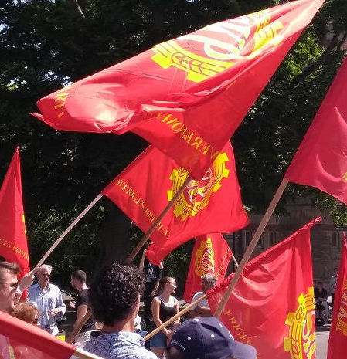

Slide 2
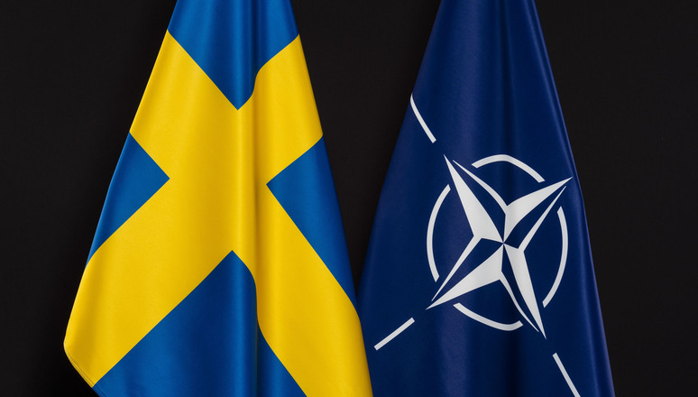
Sweden and NATO - aspirations of the Swedish bourgeoisie in the imperialist competition
Schedule
1. The Swedish model and the non- . . alignment policy
2. Leninist analysis: debunking the myths
Break (5 min)
3. Non-alignment movement today
– what is the role of the communist . party?
Sweden and NATO 2022

Slide 3
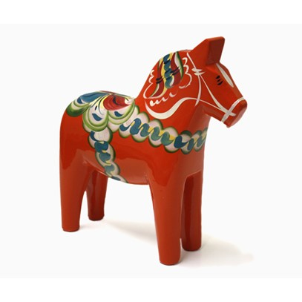
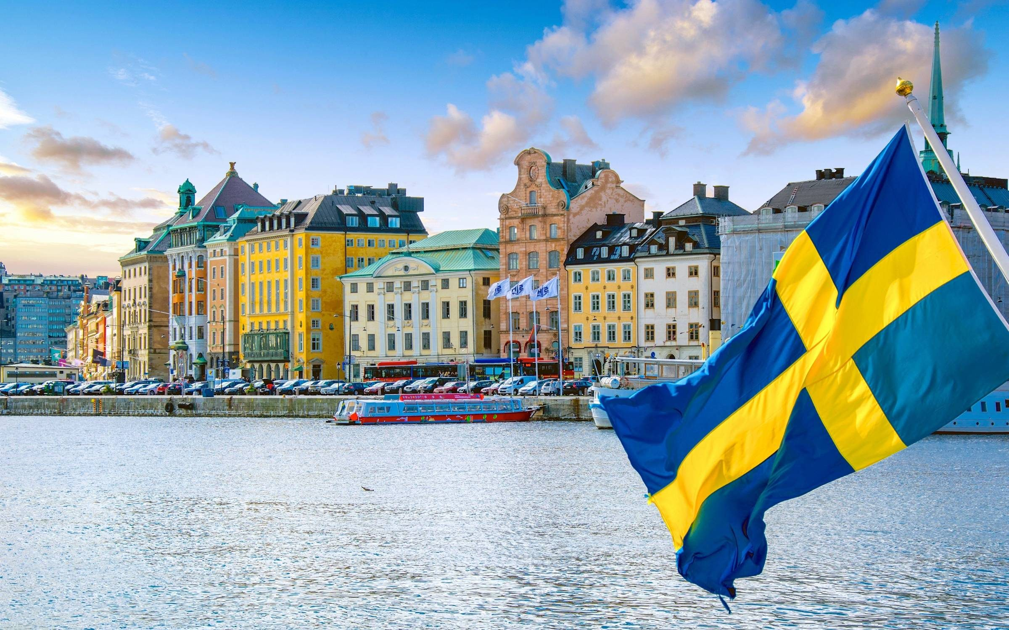
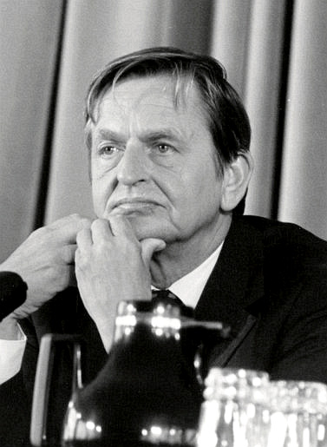
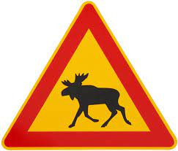
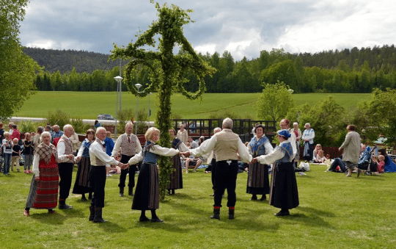
Sweden?
Sweden and NATO 2022

Slide 4
1. The Swedish model and . the non-alignment policy
Sweden and NATO 2022

Slide 5
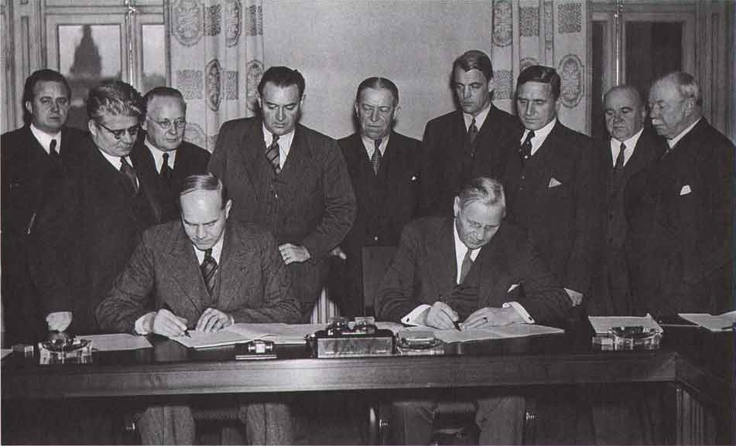
The swedish model
“a comprehensive welfare state and multi-level collevtive bargaining based on the economic foundations of social corporatism, and a commitment to private ownership within a market-based mixed economy. […] Although it was developed in the 1930s under the leadership of social democrats, the Nordic model began to gain attention after World war II.”
Sweden and NATO 2022

Slide 6
Non-alignment policy
Sweden and NATO 2022

Slide 7
2. Leninist analysis: . debunking the myths
Sweden and NATO 2022

Slide 8
Origins of the Swedish model
1889 creation of SAP (Branting vs Palm)
1898 Landsorganisationen (LO)
1902 Svenska Arbetsgivarförening (SAF) (after political strikes)
1906 December-agreement
The beginning of class collaboration
Sweden and NATO 2022

Slide 9
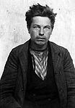
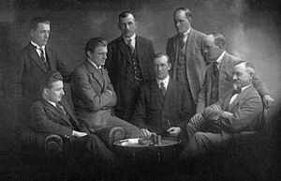
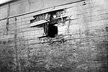
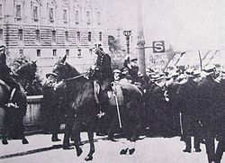
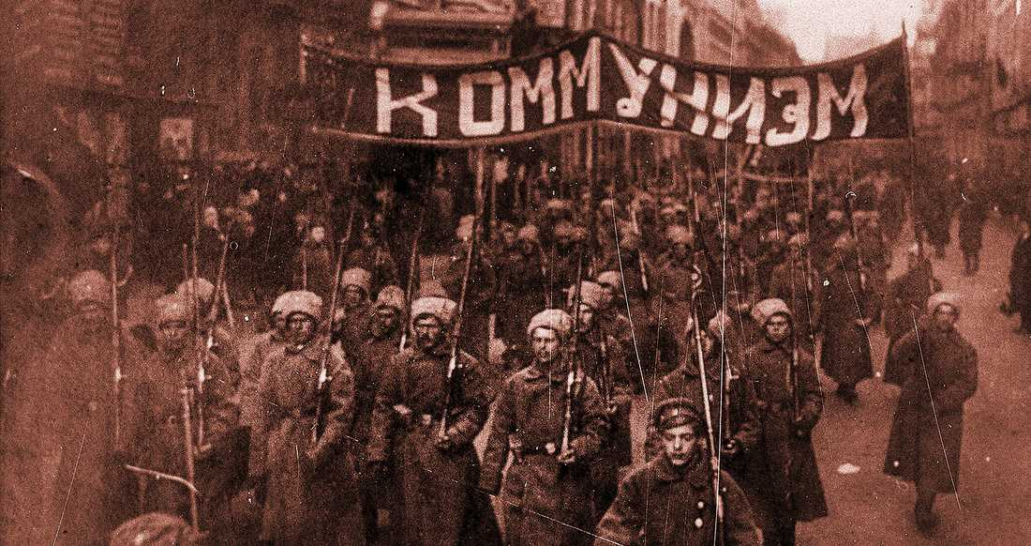
Origins of the Swedish model
1906-1909 strikes against the december- . Agreement
1917 Communist Party of Sweden
Social unrest
1918-1920 Reforms
SKP:s riksdagsgrupp 1922
Sweden and NATO 2022

Slide 10
1928 Laws on labour peace
Law on collective bargaining: ”peace obligation”
Labour courts
SKP push forward strikes in protest
Leadership of LO:s defends ”spirit of concensus”, fights the communists
LO cuts the wings of the working class 1928
Sweden and NATO 2022

Slide 11
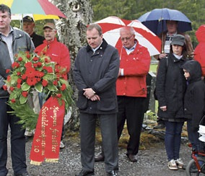
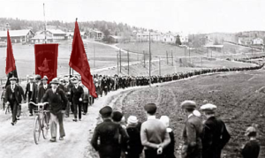
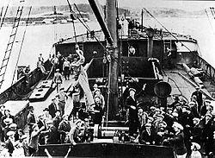
Results?
Sweden and NATO 2022

Slide 12
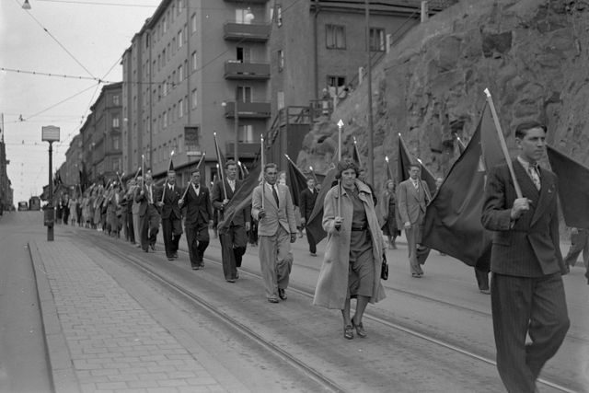
SKP as a factor of power
Valresultat riket:
20-talet: 4-8 %
30-talet: 3-4 % (splittring)
40-talet: 4-10 %
Norrbotten/Värmland 1924-1952:
Kiruna 35-51 %
Tärendö 38-48 %
Gällivare
Luleå 26-34 %
Kramfors
Hagfors
Sweden and NATO 2022

Slide 13
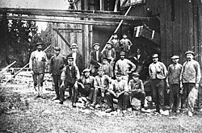
SKP as a factor of power
Dominant power in
Stockholms, Göteborg
Gävleborg, Värmland
Västernorrland, Norrbotten
Challenger of power in:
Paper, Metal
Construction, Transport
Mines, Forestry
Röd Facklig Opposition
Decisive role in 20- 30- och 40s strike waves
Sweden and NATO 2022

Slide 14
1938 Saltsjöbaden agreement regering: Socialdemokraterna och Bondeförbundet (Per Albin Hansson)
Mammoth investigation 1936
Initative of SAP and LO: Law of notice
SAP has to back off, gets it done through LO
20 December 1938 Saltsjöbadsavtalet: - Ban on ”destructive strikes” - Ban on ”strikes with danger to the public”
. - Work has to be concluded before a strike
- disputes must be negotiated locally, then . centrally before a conflict can take place
August Lindberg (LO) and Sigfrid Ekström (SAF) sign the Saltsjöbaden agreement December 1938
Sweden and NATO 2022

Slide 15
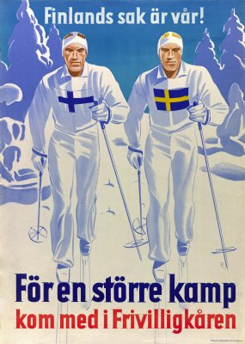
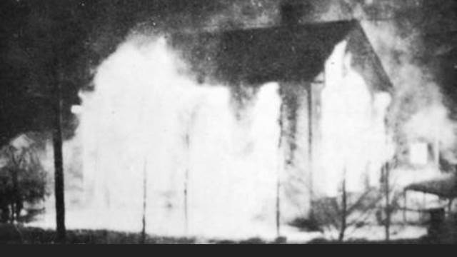
1940-41 LO fights SKP
Membership votes got banned
LO-leadership got right to veto the unions
LO call on the expulsion of communists from the unions
Sweden and NATO 2022

Slide 16
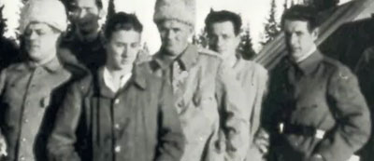
1939-45 State repression of the SKP
Ban on newspaper
Rades and inprisonment of SKPs leadership
register of 40-100 000 kommunister
Communists sent to Work camps, Sveg 1941
Sweden and NATO 2022

Slide 17
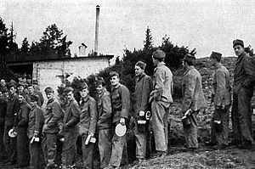
1939-45 State repression of the SKP
Work camps for communists:
Storsien (Kalix), Naartijärvi (Haparanda)
Öxnered (Vänersborg), Grytan (Östersund)
Stensele, Vindeln (Västerbotten)
Dalarö, Lövnäsvallen (Sveg)
Långmora, Smedsbo (Falun)
Rinkaby, Lagerlingen (Gotland)
Backamo (Uddevalla)
kommunister in work camp in
Storsien 1940
Sweden and NATO 2022

Slide 18
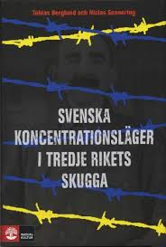
1939-45 State repression of the SKP
Concentration camps
4 000 foreign communists
National Board of Health and Welfare – Gustav Möller
Tobias Berglung, 2008
Sweden and NATO 2022

Slide 19
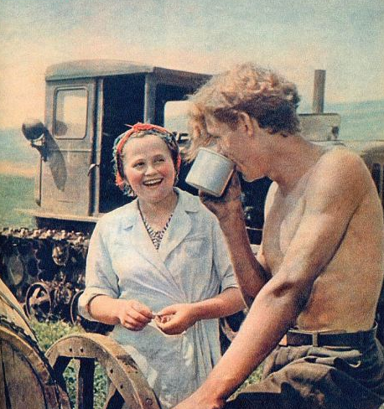
Break (5 min)
Sweden and NATO 2022

Slide 20
What has the Swedish model provided to the monopolies?
Stability in production – combatting communists strikes
Stability in finance, possibility to control the real wages
Stability in power, the parties don´t take any hits for the policies being put forward.
Possibility of making big changes in a smooth way, sometimes even with the working class appearing as the initiators (capitalism still as a progressive power) and an unprecedented trust in the state
Sweden and NATO 2022

Slide 21
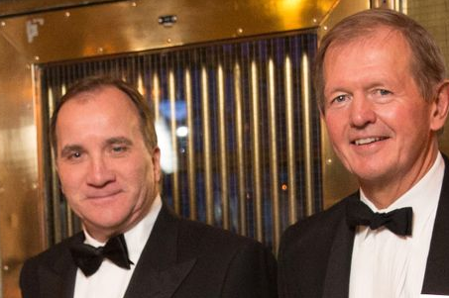
Concentration of Swedish capital
15 families own 70 % of Stockholm stock exchange
Stefan Löfvén and Marcus Wallenberg planining weapon deals with Saudiarabia 2016
Sweden and NATO 2022

Slide 22
The 15 families
Kamprad (Ikea, Ikano)
Persson (H&M)
Rausing (TetraPak)
Stenbeck (Kinnevik, MTG-media)
Bonnier (media)
Douglas (Latour)
Schörling (Assa, Hexagon)
Ax:son Johnson (bl.a. livsmedel)
Lundin (Råvaror)
Lundberg (Handelsbanken)
Bennet (medicinteknik)
Paulsson (Peab)
Olsson (Stena line)
Söderberg (Ratos)
Sweden and NATO 2022

Slide 23
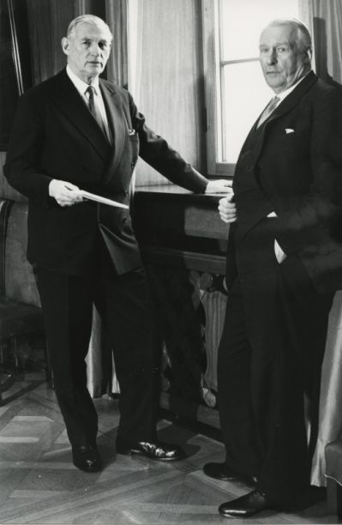
Wallenberg
Sweden and NATO 2022

Slide 24
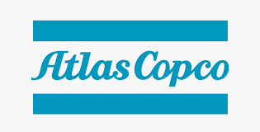
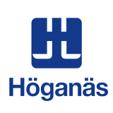
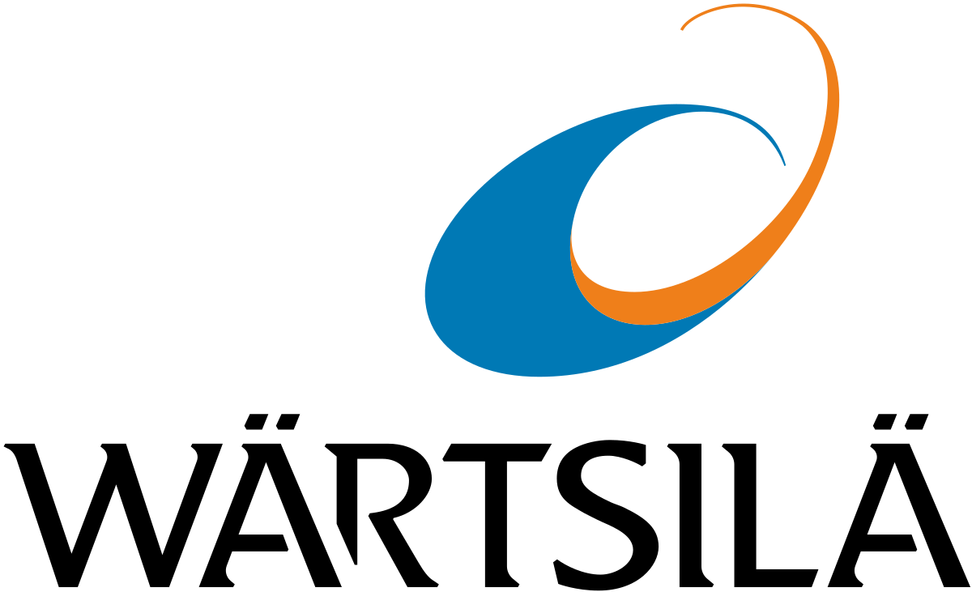
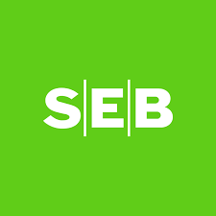
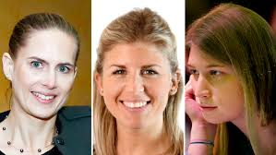
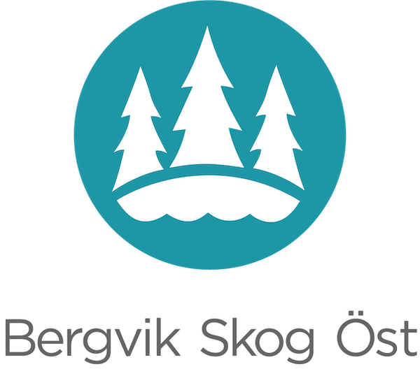
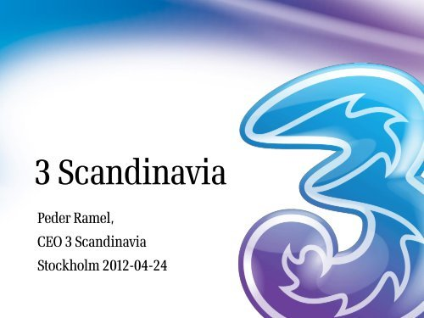
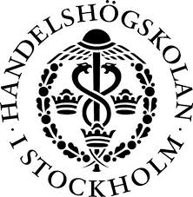
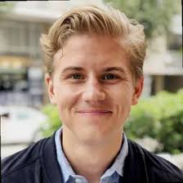
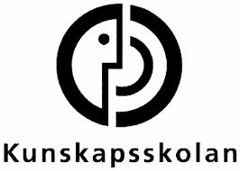
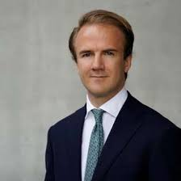
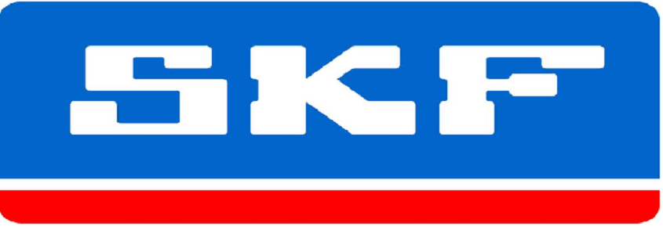
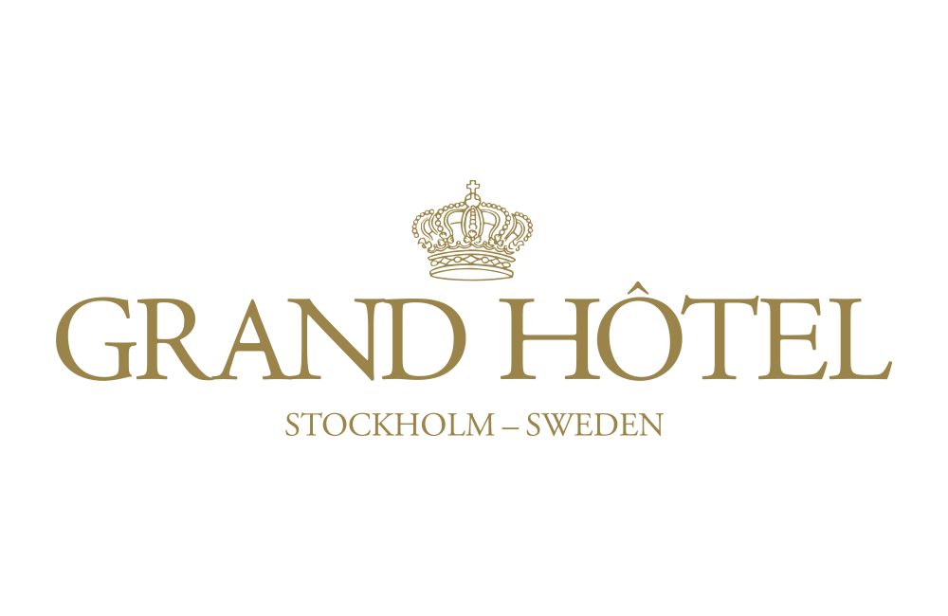
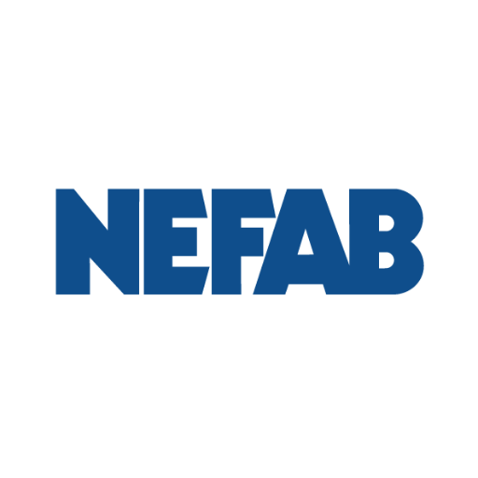
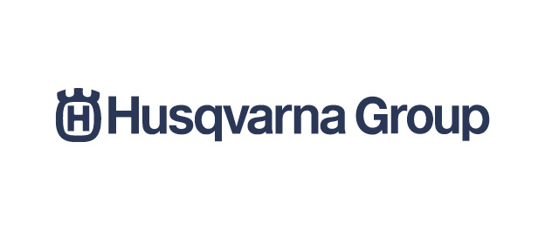
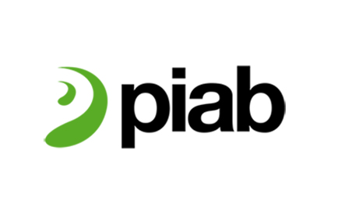
Wallenberg
6:e generationen

Slide 25
Implementing a new strategy
Dismantling of the Swedish model
Joining NATO
Sweden and NATO 2022

Slide 26
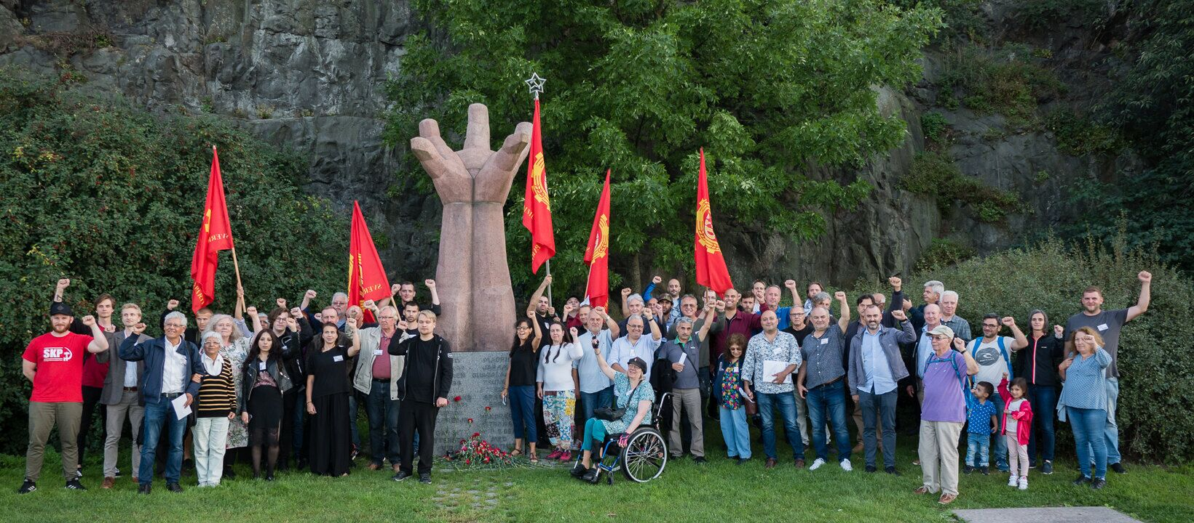
Swedish ”neutrality” in history
Sweden and NATO 2022

Slide 27
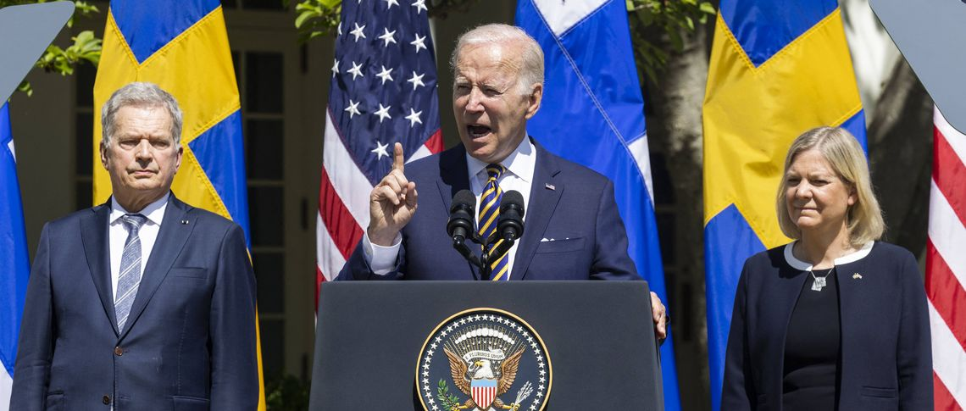
Why join NATO?
Sweden and NATO 2022

Slide 28
3. Non-alignment movement today What is the role of the communist party?
Sweden and NATO 2022

Slide 29
Non-alignment movement today What is the role of the communist party?
- No significant movement against NATO
- Joining NATO is in the interests of the Swedish monopolies
- Opportunists express the old strategy of the capitalists
- Importance of an up-to-date vitalized Marxist-Leninist analysis and understanding of imperialist system

